Slide 1

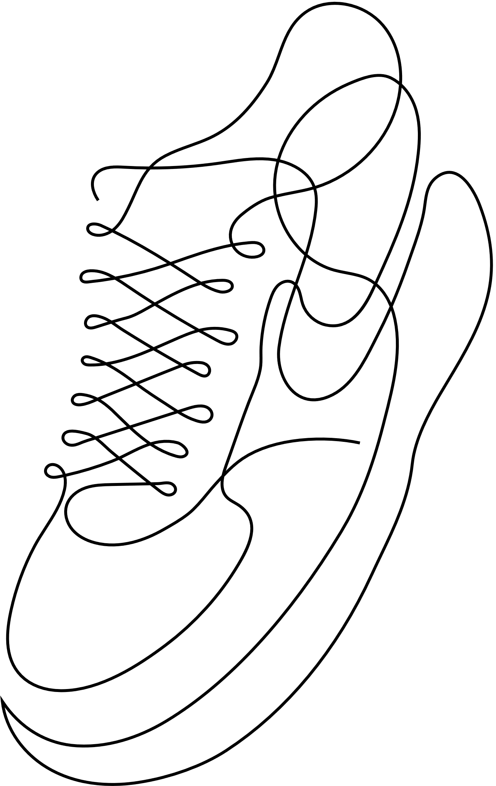
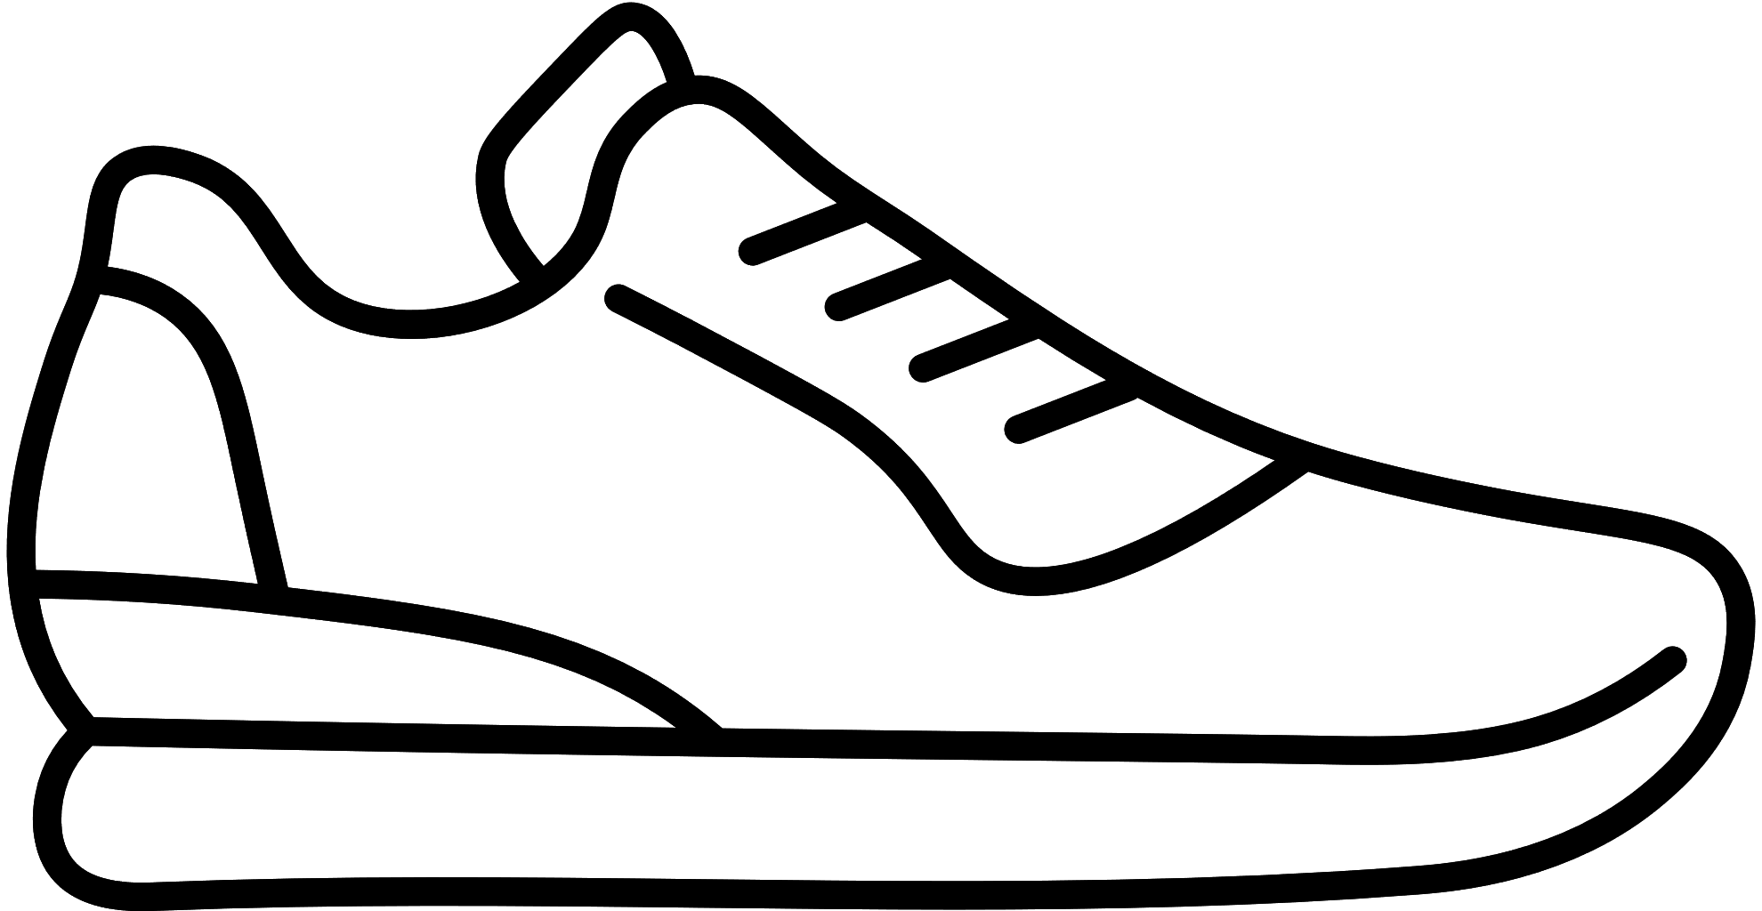
A COMPUTER NETWORKS PROJECT
Advanced Footwear Technology for
Enhanced Mobility and Safety of the
Visually Challenged
By :
Rishi Senthil Kumar - 21BLC1045
Rajasekhar S - 21BLC1672
Jagadeshwar Muthukumaran - 21BLC1277

Slide 2

Table of Contents
Abstract
Objective
Background
Literature Survey
Problem Description
Research Gap
Proposed Methodology
Tools
Results and Discussion
References

Slide 3
Abstract
The project focuses on creating creative answers to the mobility issues experienced by people with vision impairments, and intends to produce a specialised footwear system that improves the users' mobility, safety, and general quality of life by utilising technology like sensor systems and artificial intelligence. Numerous sensors, including proximity sensors, will be included into the suggested footwear technology in order to collect information about the user's surroundings and foot motions in real-time. An intelligent system that analyses the data and gives the user pertinent feedback will process this data. The user may manage their surroundings with enhanced confidence and a lower chance of accidents thanks to the feedback, which might come in the form of vibrations or audio signals.

Slide 4
Objective
The objective of this project is to develop innovative solutions that address the unique needs and challenges faced by individuals with visual impairments. Here, we integrate sensors and object detection capabilities into the footwear to detect and alert the wearer about obstacles or hazards in their vicinity, such as curbs, stairs, or low-hanging obstacles, and also, enable footwear to provide information about the surrounding environment, including auditory cues or voice prompts to indicate the presence of nearby landmarks, intersections, or points of interest.

Slide 5
Background
According to the World Health Organization (WHO), there are approximately 36 million blind people worldwide, and another 217 million people with moderate to severe vision impairment. Navigating the physical environment can be a significant challenge for individuals with visual impairments, impacting their independence and quality of life.
Our project combines the principles of assistive technology, sensor technology, and human-centered design to address the specific needs and challenges faced by blind individuals in mobility and navigation. By providing real-time obstacle detection and audio alerts through footwear, this innovation has the potential to empower blind individuals, improve their daily lives, and promote inclusivity in society.

Slide 6
Literature Survey
Title of paper and Authors | Journal/Conference and year | Concept/Approach | Limitation | Inference
Distance Measurement of an Object or Obstacle by Ultrasound Sensors using P89C51RD2 A. K. Shrivastava, A. Verma, and S. P. Singh | International Journal of Computer Theory and Engineering, 2010 | This paper proposes a model using P89C51RD2 microcontroller with Ultra Sound sensor | Too big, will not suit day to day use | A large device will not be useful in day to day activities for visually impaired people
Pedestrian and Vehicle Detection for Visually Impaired People Shripad Bhatlawande, Shaunak Dhande, Dhavanit Gupta, Jyoti Madake & Swati Shilaskar | International Conference on communications and Cyber Physical Engineering, 2018 | This paper proposes a model that can detect and classify pedestrians and vehicles on road using machine-learning and computer vision approaches. | High Tech Cameras will be too expensive and vulnerable | The device should be affordable and strong
Obstacle and Fall Detection to Guide the Visually Impaired People with Real Time Monitoring Mohammad Marufur Rahman, Md. Milon Islam.Shishir Ahmmed | SN Computer Science, 2020 | This paper proposes a method in which the device will use accelerometer to detect any fall and inform a third person through bluetooth | This will require the presence of a third person, if that person is not available then it will be tough for the user | The device should not require the presence of a third person

Slide 7
Literature Survey
Title of paper and Authors | Journal/Conference and year | Concept/Approach | Limitation | Inference
Obstacle Detection Techniques in Outdoor Environment: Process, Study and Analysis Yadwinder Singh, Lakhwinder Kaur | International Journal of Image, Graphics and Signal Processing · May 2017 | This paper proposes a comprehensive and critical survey of Image Processing techniques like vision based, ground plane detection, feature extraction, etc. for detecting the obstacles | This approach is more costly and requires more computational requirements | The device should be simple and more affordable
Intelligent Navigation System for Blind People with Real Time Tracking K. Rajan , E. Kalaiselvan | International Journal of Engineering Research & Technology, 2018 | This project is realized with the generation of vibration and through the voice module | A stick providing vibrations cannot be always reliable, if the cane is pointing is a different side | A cane with a sensor isn’t reliable

Slide 8
Problem Description
The visually challenged face significant challenges in navigating their surroundings independently and safely. Existing mobility aids for the visually impaired often lack realtime feedback and fail to address the specific needs of users in various environments. Therefore, there is a need for an innovative solution that utilizes advanced technology to develop Arduinobased smart shoes capable of enhancing mobility and safety for visually challenged individuals.

Slide 9
Research gap
Requires a third person
More costly and requires more computational requirements
Long-Term Usability and Comfort

Slide 10
Proposed Methodology
Arduino-Based Assistive Device for Enhanced Mobility and Safety of the Visually Challenged To address the challenges faced by visually challenged individuals in enhancing their mobility and safety
Obstacle Detection: The device will incorporate obstacle detection sensors, such as ultrasonic to detect objects or obstacles in the user's path. The sensors will provide feedback, such as auditory or through a speaker, to alert the user about the presence and proximity of obstacles. This will assist users in navigating their surroundings safely and avoiding potential hazards.

Slide 11
Proposed Methodology
Bluetooth connectivity: The device will incoporate bluetooth connectivity through it, the device will be connected to the user's smartphone and will be constantly providing alters of obstacles in the surrounding which the user can hear through bluetooth earphones connected to their smartphone

Slide 12
Tools
Arduino IDE: The Arduino software, also known as the Arduino Integrated Development Environment (IDE), is a programming environment specifically designed for creating and uploading code to Arduino microcontroller boards.
The Arduino software provides a range of functions and libraries that simplify the process of working with hardware components and peripherals. These libraries include pre-written code snippets that you can use to interact with sensors, motors, displays, and other electronic components.

Slide 13
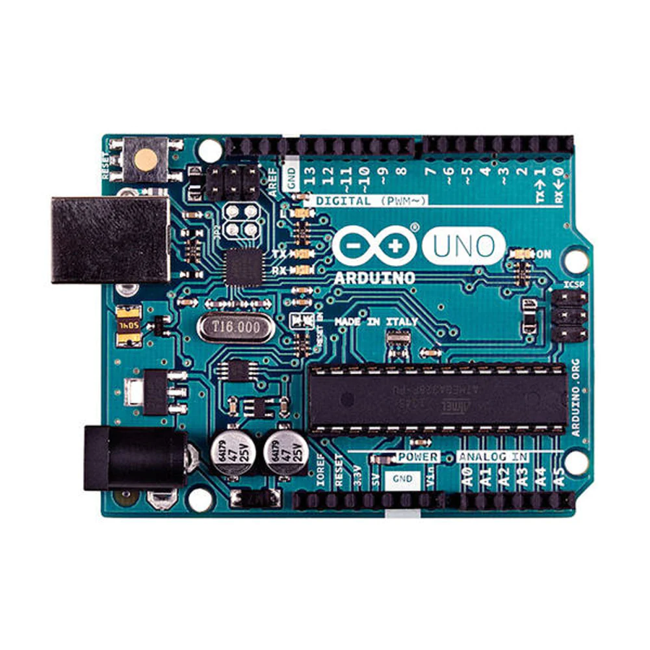
Tools
Arduino microcontroller: The Arduino microcontroller board serves as the core of the platform. It is equipped with a microcontroller chip, which is essentially a small computer on a single integrated circuit. The board also features input and output pins that can be used to connect various electronic components

Slide 14
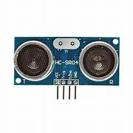
Tools
Ultrosonic Sensor: An ultrasonic sensor is a device that uses sound waves to detect and measure distances to objects. It works on the principle of sending out high-frequency sound waves and then measuring the time it takes for the waves to bounce back after hitting an object.

Slide 15
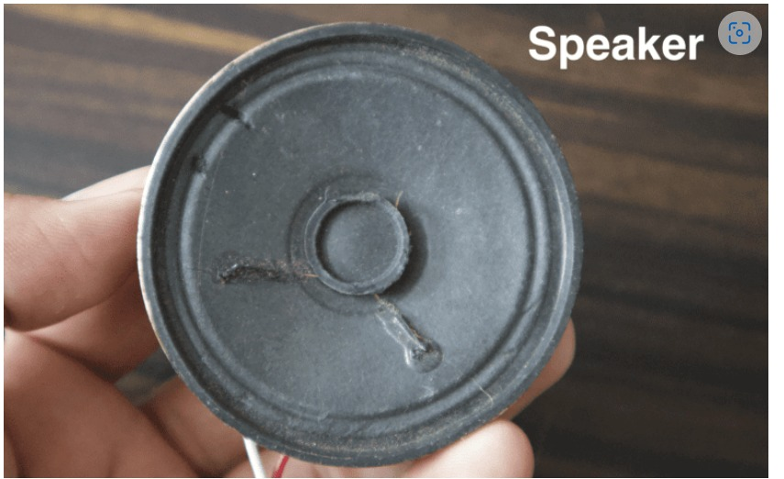
Tools
Speaker: A speaker is a device that converts electrical signals into sound waves, allowing us to hear audio

Slide 16
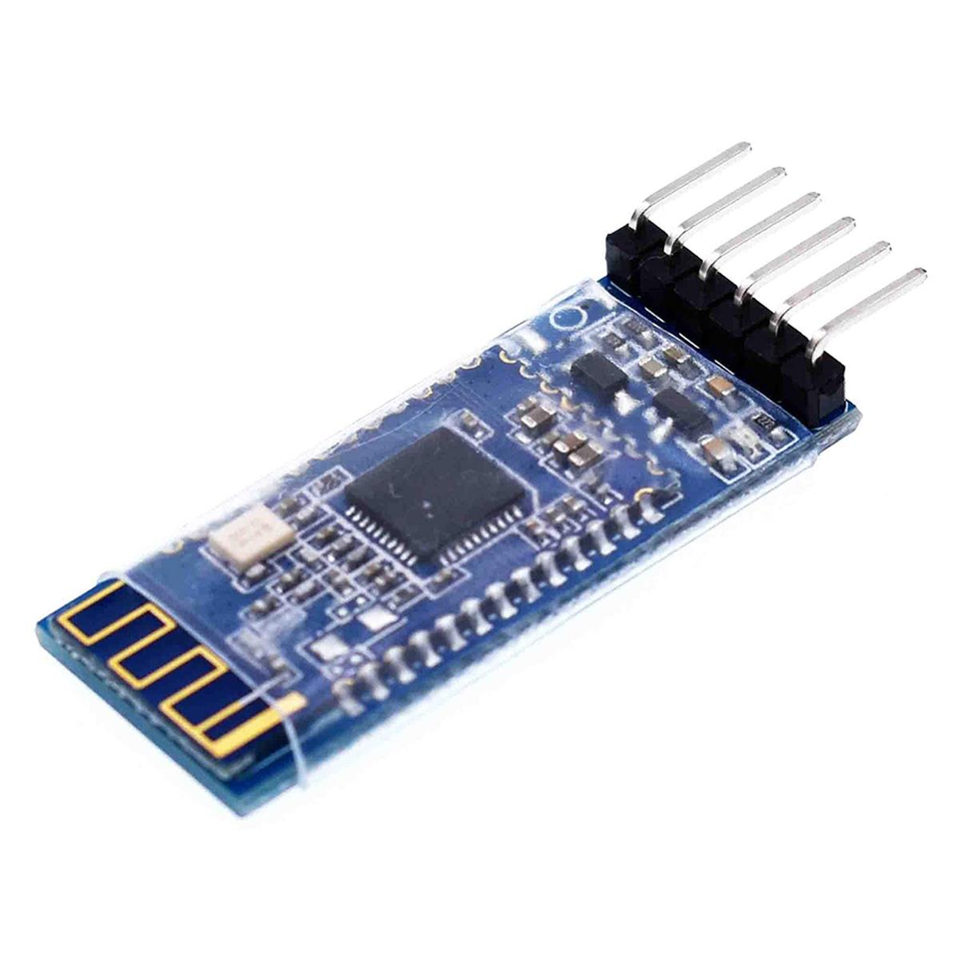
Tools
Bluetooth Module: A Bluetooth module for Arduino is a device that enables wireless communication between an Arduino board and other Bluetooth-enabled devices, such as smartphones, tablets, and computers. It allows you to establish a wireless connection and exchange data or control signals over short distances.

Slide 17
Results and Discussion
Source Code
const int trigPin = 8;
const int echoPin = 7;
const int speakerPin = 11;
const float distanceThreshold = 50.0; // Distance threshold in cm
void setup() {
Serial.begin(9600);
pinMode(trigPin, OUTPUT);
pinMode(echoPin, INPUT);
pinMode(speakerPin, OUTPUT);
}

Slide 18
Results and Discussion
void loop() {
digitalWrite(trigPin, LOW);
delayMicroseconds(2);
digitalWrite(trigPin, HIGH);
delayMicroseconds(10);
digitalWrite(trigPin, LOW);
long duration = pulseIn(echoPin, HIGH);
float distance = duration * 0.034 / 2;
if (distance < distanceThreshold) {
Serial.print("OBJECT DETECTED!! Distance: ");
Serial.print(distance);
Serial.println(" cm");

Slide 19
Results and Discussion
tone(speakerPin, 1000);
delay(500);
noTone(speakerPin);
}
delay(500);
}

Slide 20
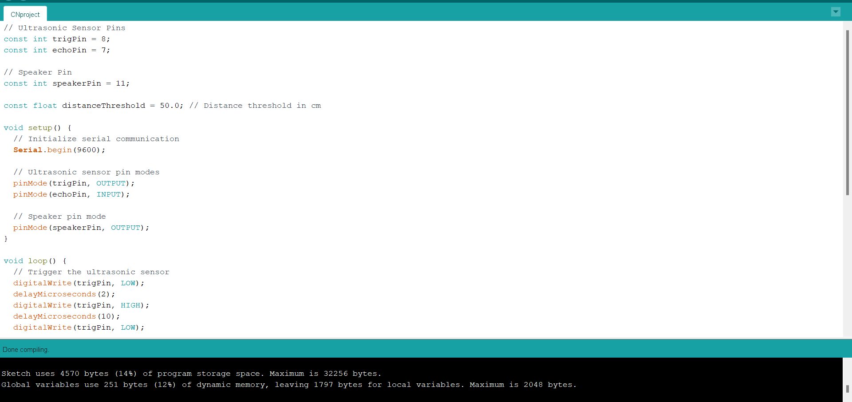
Results and Discussion
Compiling in Arduino IDE

Slide 21
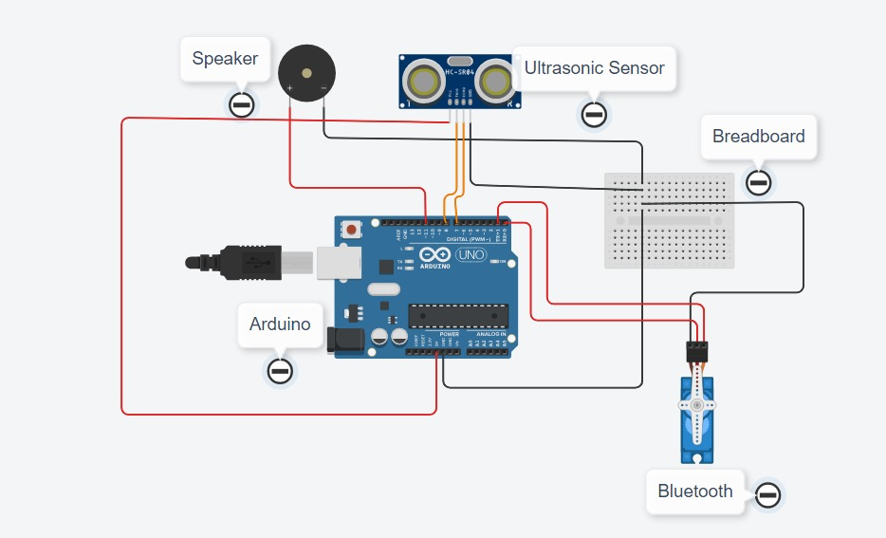
Results and Discussion
Circuit

Slide 22
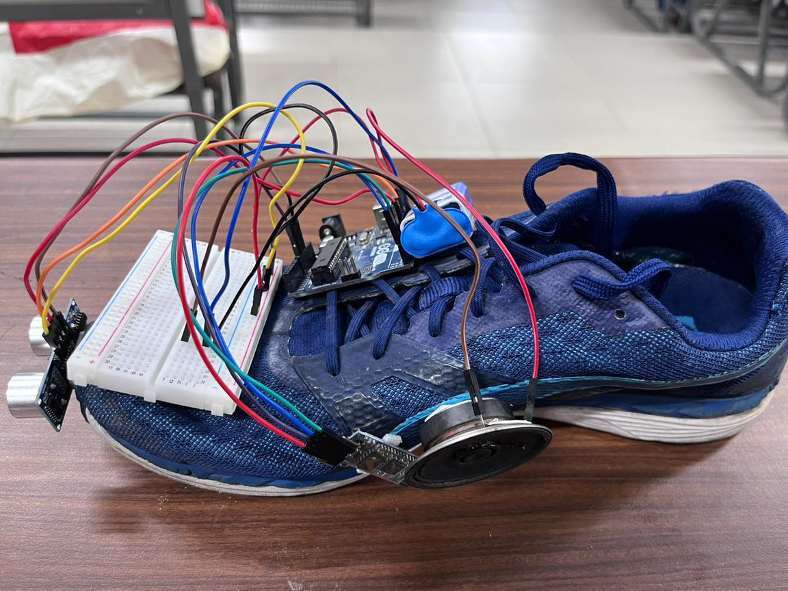
Results and Discussion
Connecting all the components using jumper wires
We place the ultrasonic sensor at the front to detect obstacles
After loading the code in Arduino we disconnect the laptop and add a 9V battery for power

Slide 23
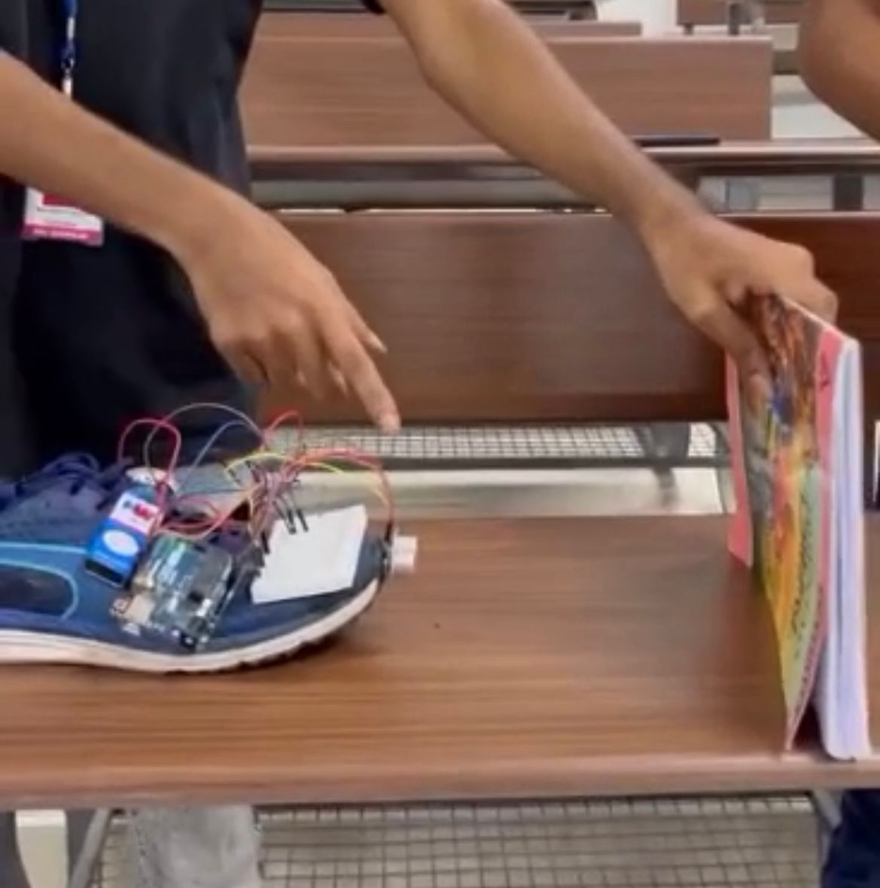
Results and Discussion
When the ultra sonic sensor detects obstacle the device alerts the user through speaker and bluetooth

Slide 24
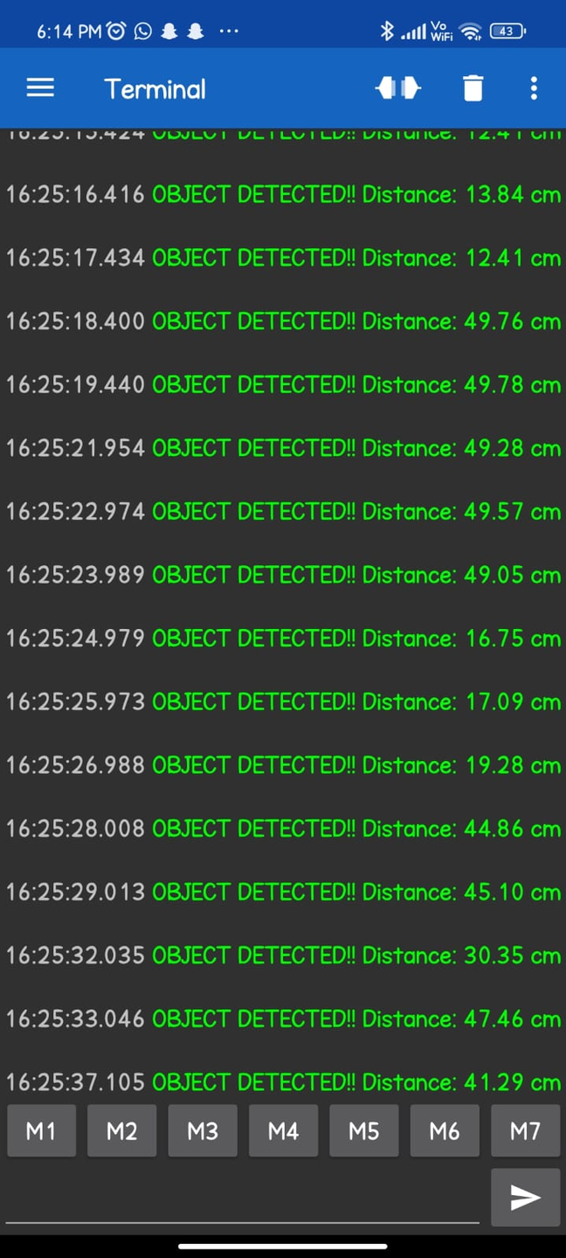
Results and Discussion
When the obstacle is detected the device will send a message to the user's phone through bluetooth which they will be aware of through bluetooth earphones

Slide 25
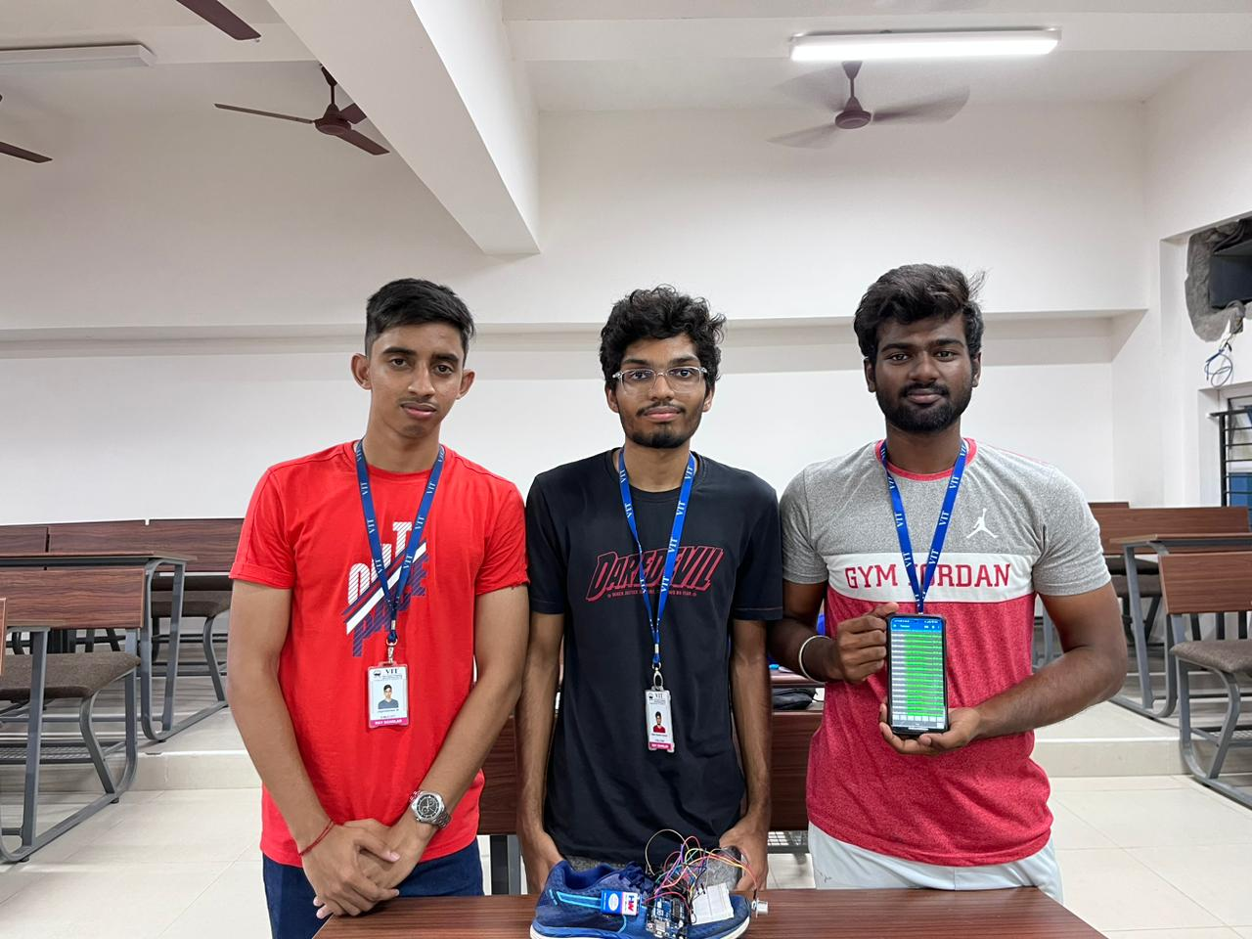
Results and Discussion
Demonstration Video Link : https://drive.google.com/drive/folders/1GsEjNN2pX-Pse0jYxjkeGYDFMEpdd74c?usp=sharing

Slide 26
References
1. Distance Measurement of an Object or Obstacle by Ultrasound Sensors using P89C51RD2 A. K. Shrivastava, A. Verma, and S. P. Singh,International Journal of Computer Theory and Engineering, Vol. 2, No. 1 February, 2010 1793-8201
2. An Approach for Precise Distance Measuring Using Ultrasonic Sensors,Faculty of Information Technology and Control, Azerbaijan State Oil and Industry University, Presented at the 1st International Electronic Conference on Machines and Applications, 15–30 September 2022;
3. Analysis of Obstacle Detection Using Ultrasonic Sensor Christofer N. Yalung, Cid Mathew S. Adolfo,International Research Journal of Engineering and Technology (IRJET) Jan -2017

Slide 27
References
4. Developing a Bluetooth Based Tracking System for Tracking Devices Using Arduino,Francis Kwabena,Hannah Adjei,George Agordzo, Conference: 2020 5th International Conference on Computing, Communication and Security (ICCCS)
At: Patna, India
5. Home automated system using Bluetooth and an android application,
Abiodun E. Amoran, Ayodele S. Oluwole , Enitan O. Fagorola , R.S. DiarahScientific African March 2021, e00711
,

